Slide 1
The Normal Distribution, Z-Scores, and Confidence INtervals

Slide 2
Frequency Distributions
The histogram or distribution based on our real data

Slide 3
Probability Distributions
Ideal/Theoretical
Like frequency distribution except that its based on probability theory (not real data)
as if researcher (hypothetically) collected all possible scores

Slide 4

Probability Theory
$$Probability of an event= \frac{number of times this event \left(object\right) appears}{total number of possible events (objects)}$$

Slide 5
Probability Theory
Probability (P) varies from 0 to 1.0
0.0 = impossible
1.0 = certain
Can be extremely unlikely (.01) to very probable (0.95)

Slide 6
Distributions and Probability

Slide 7
Differences b/w Probability and Frequency Distributions
Probability distribution is theoretical ideal
If we flipped one coin an infinite number of times
Things would even out to expected probability (.50 probability of heads)
We can calculate the empirical probability (those based on trials)
Take the mean of the trials: heads == 1, tails == 0

Slide 8
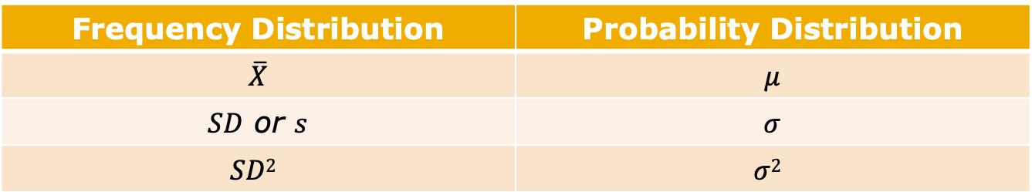
Estimates in Frequency and Probability Distributions
Probability we expect for a given event with (nearly) infinite numbers of any event
Frequency Distribution | Probability Distribution
$$\overline{X}$$ | $$μ$$
$SD$ or $s$ | $$σ$$
$$SD2$$ | $$σ2$$

Slide 9
Normal Curve as a Probability Distribution
Normal Curve used to
Demonstrate spread of scores (using Standard Deviation)
Making statements of probability

Slide 10
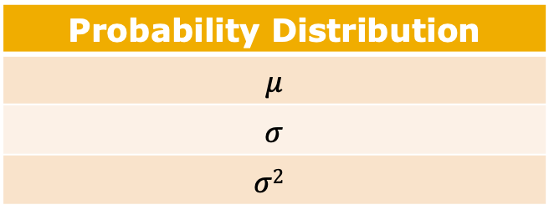
Characteristics of the Normal Curve
Symmetrical (no skew)
Mesokurtic
Unimodal
Mean, median, mode all at center
Theoretical (probability distribution)
Probability Distribution
$$μ$$
$$σ$$
$$σ2$$

Slide 11

Area Under the Normal Curve
We know that 100% of all cases that exist fall under the curve
Normal curve has a mean of $μ$ and a standard deviation of $σ$.
We can use the mean ($μ$) and standard deviation ($σ$) to break up normal curve

Slide 12
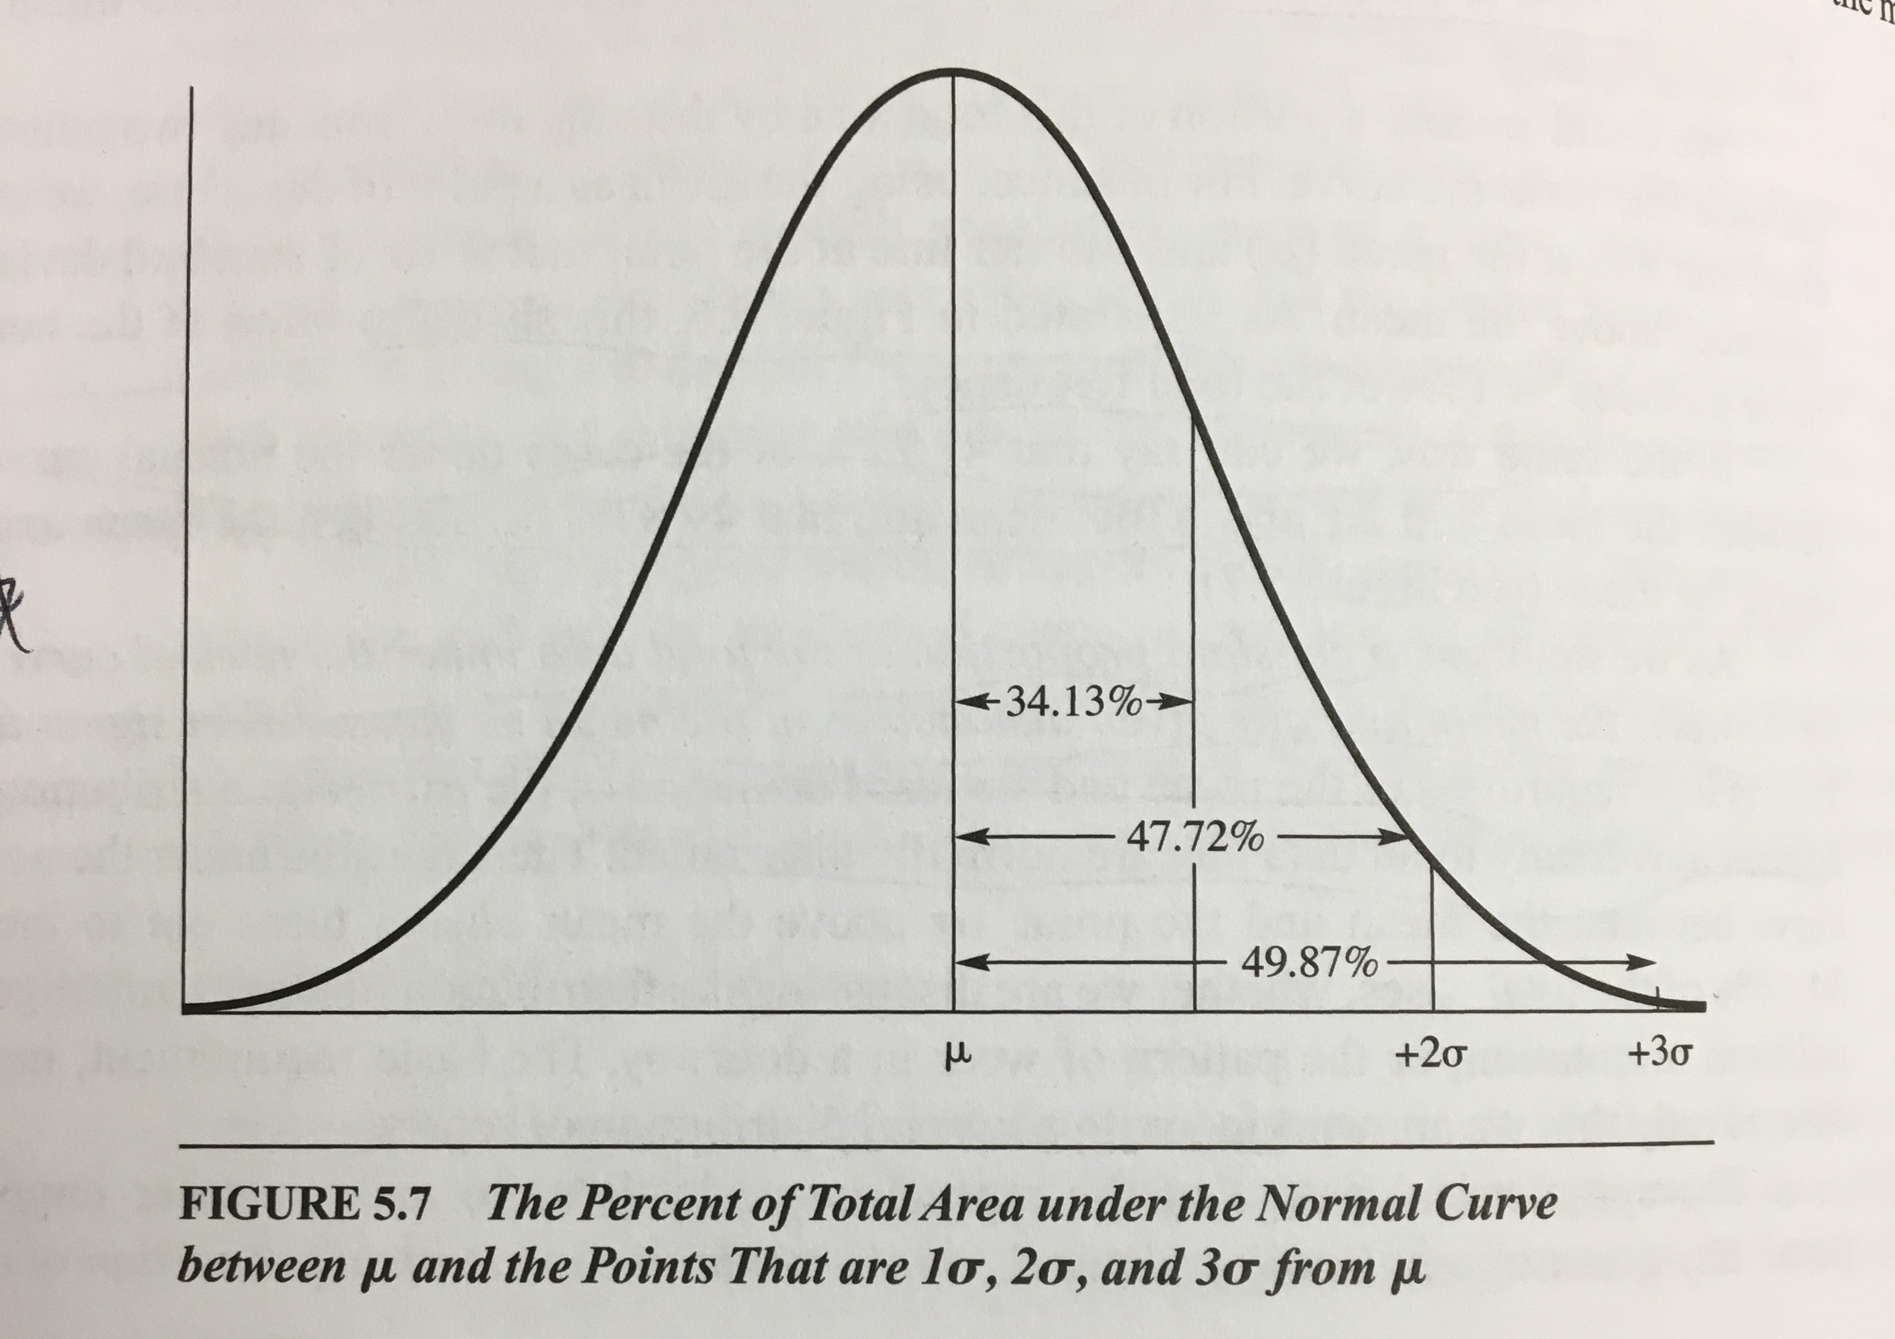
Standard Deviation and Area Under the Normal Curve
proportions? probabilities?

Slide 13
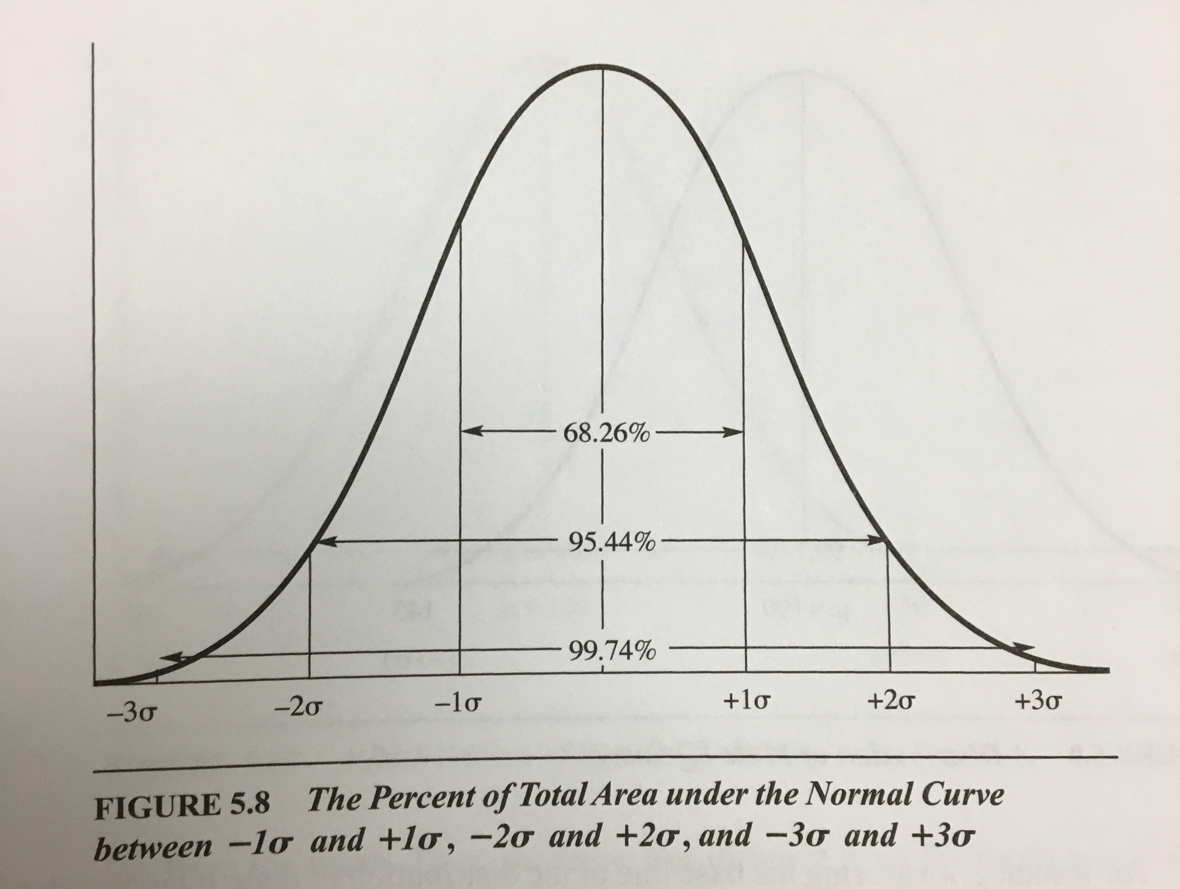

Standard Deviation and Area Under the Normal Curve
68.26% of cases fall between -1$σ$ to +1$σ$
95.44% of cases fall between -2$σ$ to +2$σ$
99.74% of cases fall between -3$σ$ to +3$σ$
proportions? probabilities?

Slide 14

Standard Deviation (Band) as a Confidence Level
68.26% confident that the true population mean (µ) falls between -1$σ$ to +1$σ$
95.44% confident that the true population mean (µ) falls between -2$σ$ to +2$σ$
99.74% confident that the true population mean (µ) falls between -3$σ$ to +3$σ$

Slide 15
Confidence Levels and their Confidence Intervals
Confidence Levels
Percentage of cases, around the mean, that are covered
How confident that your CI range includes the population mean
Confidence Intervals
Range, in standard deviation units, around the mean, that include the percentage of cases as defined by the Confidence Level

Slide 16

Confidence Levels and their Confidence Intervals
68.26% Confidence Level
Confidence Interval: $−1σ$ to $+1σ$
CI Lower bound: $μ−1σ$
CI Upper bound: $μ+1σ$
95.44% Confidence Level
$\text{Confidence} \text{Interval}\text{:}−2σ$ to $+2σ$
CI Lower bound: $μ−2σ$
CI Upper bound: $μ+2σ$
99.74% Confidence Level
$\text{Confidence} \text{Interval}\text{:}−3σ$ to $+3σ$
CI Lower bound: $μ−3σ$
CI Upper bound: $μ+3σ$

Slide 17

Calculating Confidence Intervals from Confidence Levels
If you know the mean ($μ$) and standard deviation ($σ$), you can calculate actual values for
the Confidence Interval (the Upper Bound and Lower Bound)
based on your Confidence Level

Slide 18

Confidence Interval Example: Sex Differences in IQ
Both men and women have mean IQ scores of 100, but men have more variability.
Men have more low-IQ individuals and more high-IQ individuals
Women have more individuals located toward the average
Men $σ$ = 15 points
Women $σ$ = 10 points

Slide 19

Confidence Interval Example: Sex Differences in IQ
68.26% of all male’s IQ scores fall between which -1$σ$ and +1$σ$ for their group.
68.26% of all women’s IQ scores fall between which -1$σ$ and +1$σ$ for their group.
95.44% of all male’s IQ scores fall between which -2$σ$ and +2$σ$ for their group.
95.44% of all women’s IQ scores fall between which -2$σ$ and +2$σ$ for their group.
99.74% of all male’s IQ scores fall between which -3$σ$ and +3$σ$ for their group.
99.74% of all women’s IQ scores fall between which -3$σ$ and +3$σ$ for their group.

Slide 20
Confidence Interval Example: Sex Differences in IQ
68.26% of all male’s IQ scores fall between which scores?
68.26% of all women’s IQ scores fall between which scores?
95.44% of all male’s IQ scores fall between which scores?
95.44% of all women’s IQ scores fall between which scores?
99.74% of all male’s IQ scores fall between which scores?
99.74% of all women’s IQ scores fall between which scores?

Slide 21

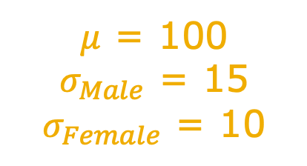
Confidence Interval Example: Sex Differences in IQ
68.26% of cases (68.26% Confidence Level)
Lower bound: $μ−1σ$
Upper bound: $μ+1σ$
95.44% of cases (95.44% Confidence Level)
Lower bound: $μ−2σ$
Upper bound: $μ+2σ$
99.74% of cases (99.74% Confidence Level)
Lower bound: $μ−3σ$
Upper bound: $μ+3σ$
$μ$ = 100
$σ_{Male}$ = 15
$σ_{Female}$ = 10

Slide 22
Calculating Confidence Intervals from Confidence Levels
We can calculate confidence interval because we are using a standardized (standard deviation unit) score
Z-Score

Slide 23

Confidence Levels, Confidence Intervals, and Z-Scores
Z-score
The number of Standard Deviation units ($σ$) a raw score (X) is from the mean ($μ$)
Z = $\frac{X − μ}{σ}$

Slide 24
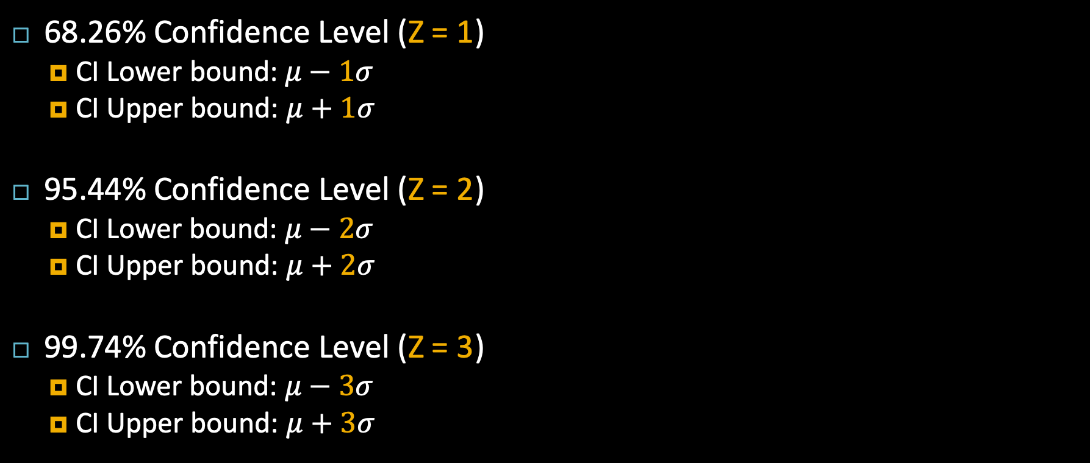
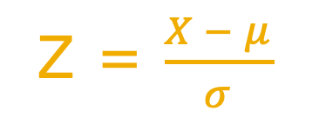
Confidence Levels, Confidence Intervals, and Z-Scores
68.26% Confidence Level (Z = 1)
CI Lower bound: $μ−1σ$
CI Upper bound: $μ+1σ$
95.44% Confidence Level (Z = 2)
CI Lower bound: $μ−2σ$
CI Upper bound: $μ+2σ$
99.74% Confidence Level (Z = 3)
CI Lower bound: $μ−3σ$
CI Upper bound: $μ+3σ$
Z = $\frac{X − μ}{σ}$

Slide 25

Confidence Levels, Confidence Intervals, and Z-Scores
Calculate Confidence Intervals
Use Z associated with Confidence Level
$μ ±$ Z$σ$
Z = $\frac{X − μ}{σ}$

Slide 26
Confidence Interval Example: Sex Differences in IQ
68.26% of all male’s IQ scores fall between which scores?
Z?
68.26% of all women’s IQ scores fall between which scores?
Z?
95.44% of all male’s IQ scores fall between which scores?
Z?
95.44% of all women’s IQ scores fall between which scores?
Z?
99.74% of all male’s IQ scores fall between which scores?
Z?
99.74% of all women’s IQ scores fall between which scores?
Z?
$μ$ = 100
$σ_{Male}$ = 15
$σ_{Female}$ = 10

Slide 27

Problem: Probability Distributions vs Empirical Distributions
Often, we don’t have data on the full population, so we won’t have a probability distribution… so we don’t know…
$μ$
$σ$

Slide 28

Problem: Probability Distributions vs Empirical Distributions
Instead, we have data on a sample, so we know…
$\overline{X}$(not $μ$)
$SD$ (not $σ$)

Slide 29
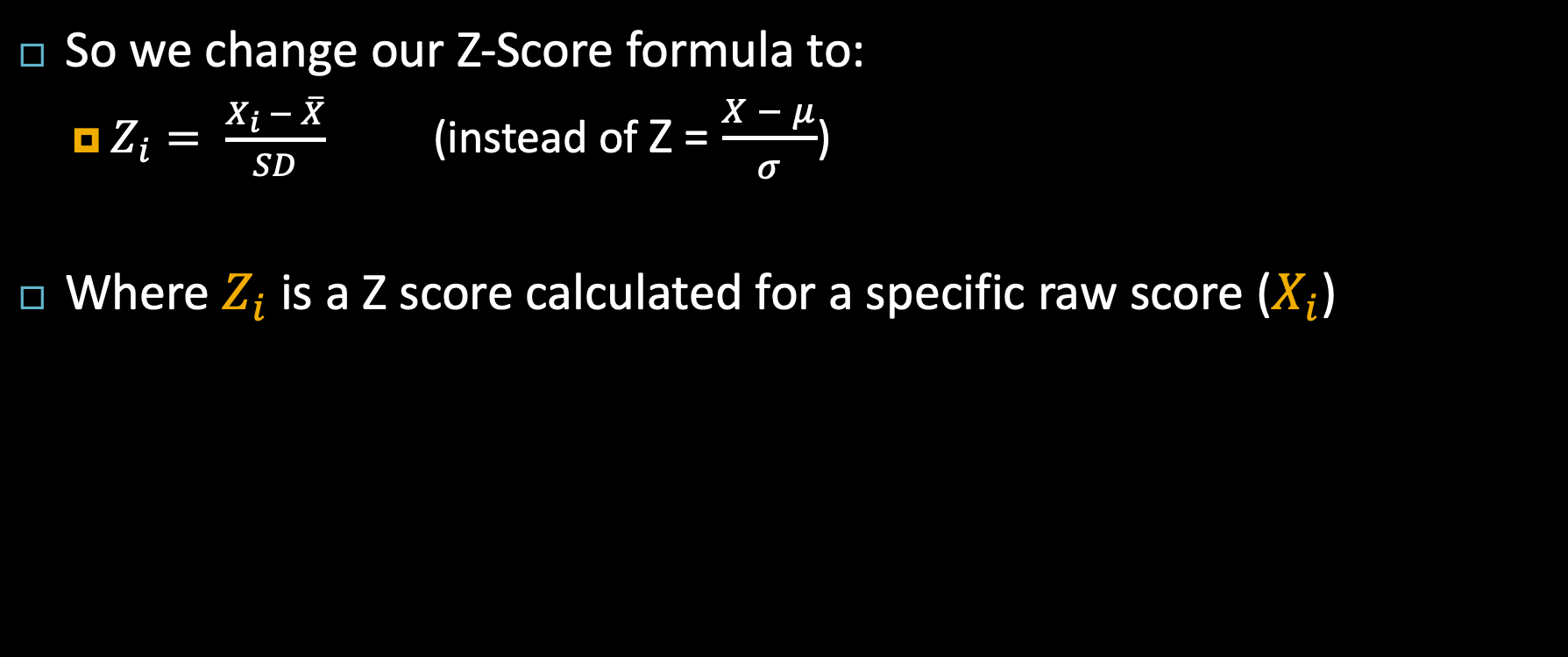
Problem: Probability Distributions vs Empirical Distributions
So we change our Z-Score formula to:
$Z_{i}= \frac{X_{i} − \overline{X}}{SD}$ (instead of Z = $\frac{X − μ}{σ}$)
Where $Z_{i}$is a Z score calculated for a specific raw score ($X_{i}$)

Slide 30
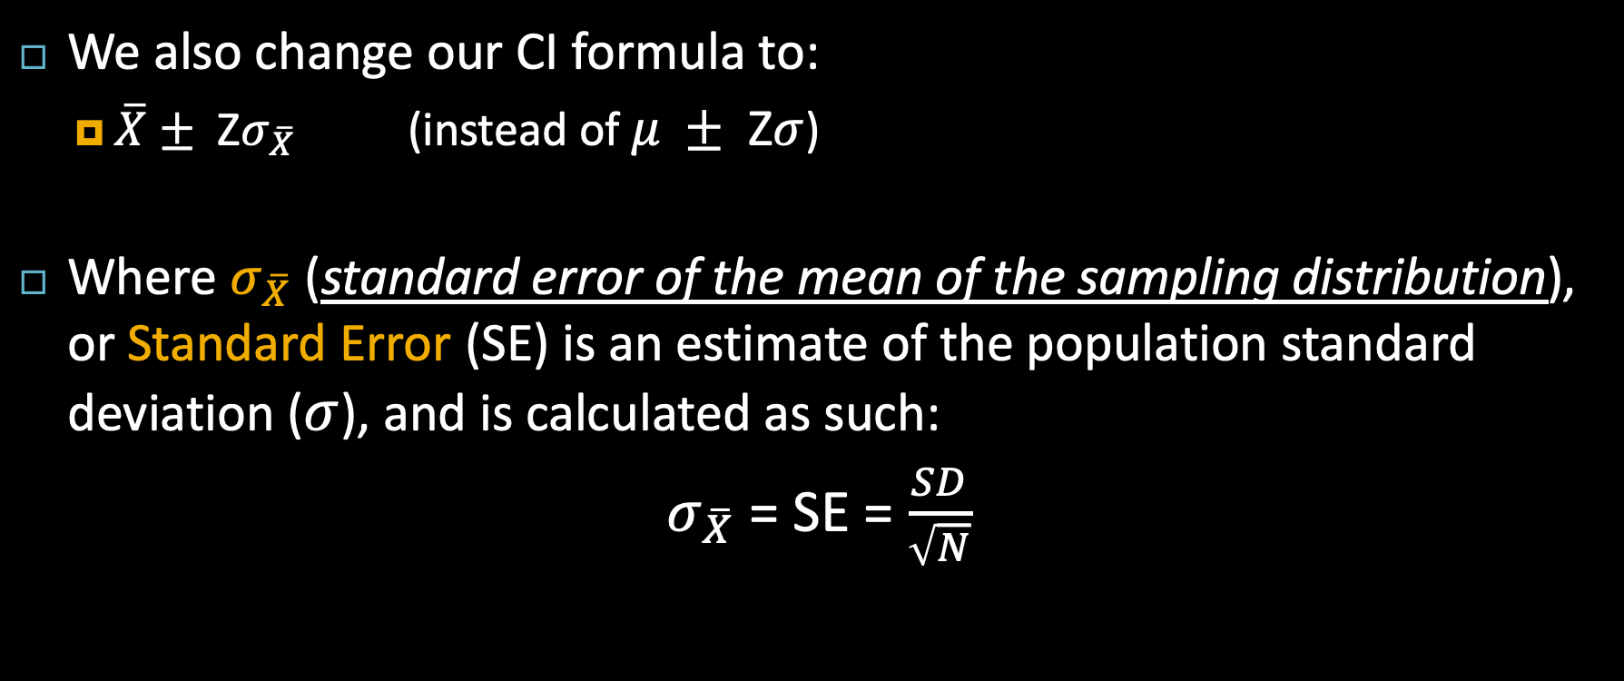
Problem: Probability Distributions vs Empirical Distributions
We also change our CI formula to:
$\overline{X}±$ Z$σ_{\overline{X}}$ (instead of $μ ±$ Z$σ$)
Where $σ_{\overline{X}}$(standard error of the mean of the sampling distribution), or Standard Error (SE) is an estimate of the population standard deviation ($σ$), and is calculated as such:
$σ_{\overline{X}}$= SE = $\frac{SD}{\sqrt{N}}$

Slide 31
More on Confidence Intervals (for Samples)
However, 68.26% confident isn’t that confident. We’re only going to be right 68.26% of the time.
To have a better probability of finding the true population mean, we need a wider and less precise interval
95% confidence interval (only wrong 5% of the time)
99% confidence interval (only wrong 1% of the time)

Slide 32
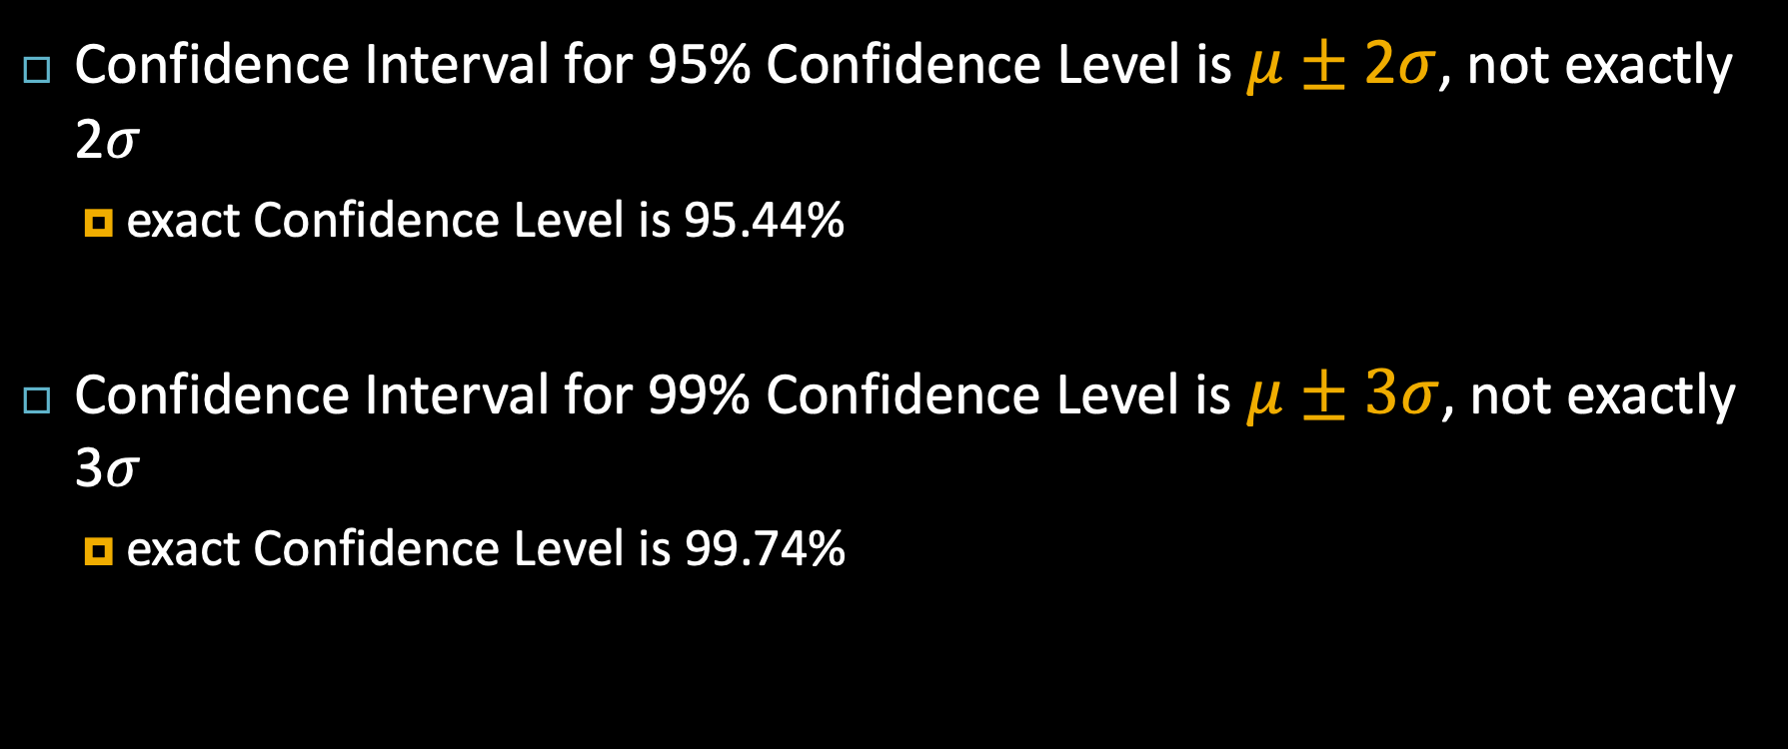
More on Confidence Intervals (for Samples)
Confidence Interval for 95% Confidence Level is $μ±$2$σ$, not exactly 2$σ$
exact Confidence Level is 95.44%
Confidence Interval for 99% Confidence Level is $μ±3σ$, not exactly 3$σ$
exact Confidence Level is 99.74%

Slide 33

More on Confidence Intervals (for Samples)
CI for 95% Confidence Level
Within 1.96$σ_{\overline{X}}$ of mean
$\overline{X}±1.96σ_{\overline{X}}$
95% confident that true population mean falls within this range
CI for 99% Confidence Level
Within 2.58$σ_{\overline{X}}$ of mean
$\overline{X}±2.58σ_{\overline{X}}$
99% confident that true population mean falls within this range

